Slide 1
SDE Major Project Group : 71 Topic: A performance comparison of SQL and NoSQL databases
Akaash Chatterjee –m24cse002
Aman Saini – m24cse003
Bera swaminath ansuman sabita – m24cse007

Slide 2
OBJECTIVE
The primary objective of this study is to benchmark the performance of various databases on common key-value operations, including read, write, delete, instantiate, and retrieve-all-keys. By comparing the performance of databases, we aim to provide insights into their suitability for various applications.
Key Operations Performed:
instantiate: Initiates / Clears the dataset for a fresh start.
read: Retrieves a value by key.
write: Inserts or updates a key-value pair.
delete: Deletes a key-value pair by key.
get all keys: Retrieves all keys in the dataset

Slide 3

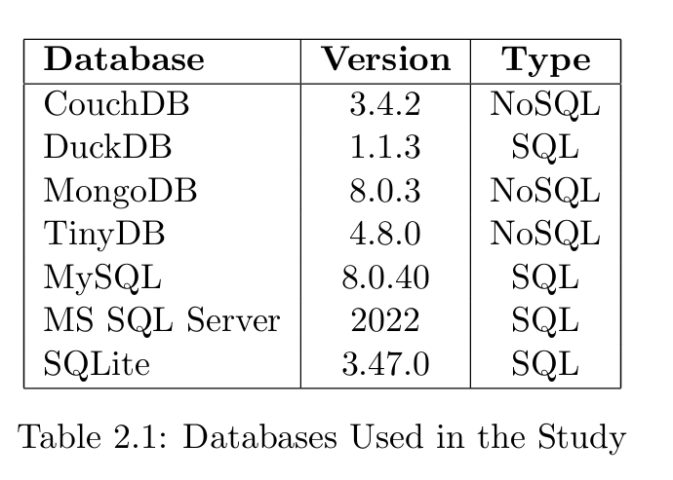






Databases Compared

Slide 4
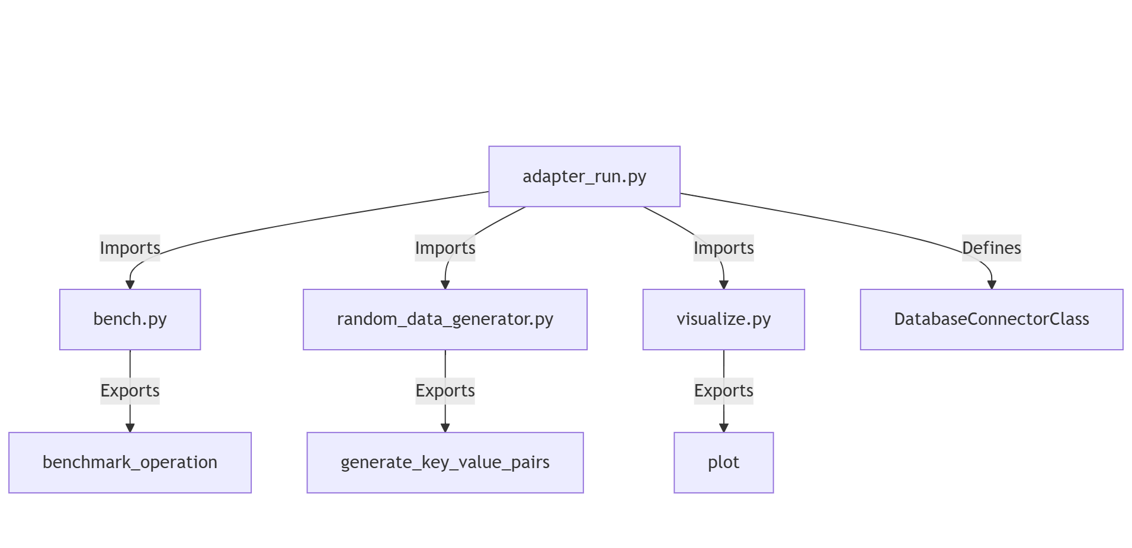
System and dependencies

Slide 5
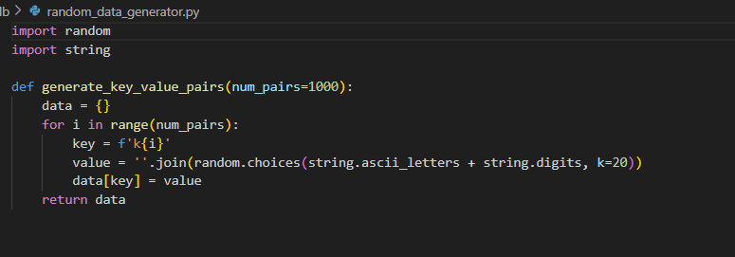
Random Data Generator

Slide 6
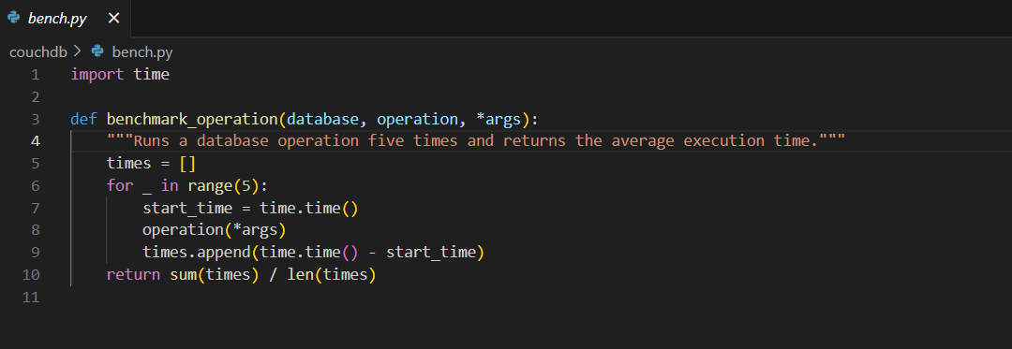
Benchmarking Module

Slide 7
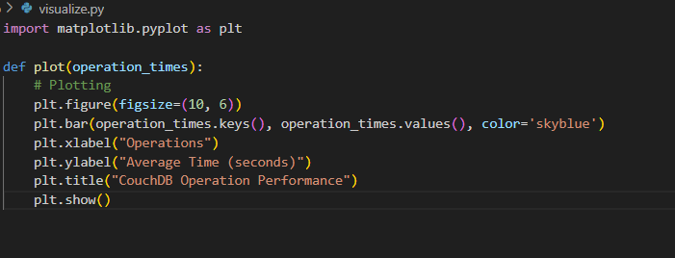
Visualization Module

Slide 8
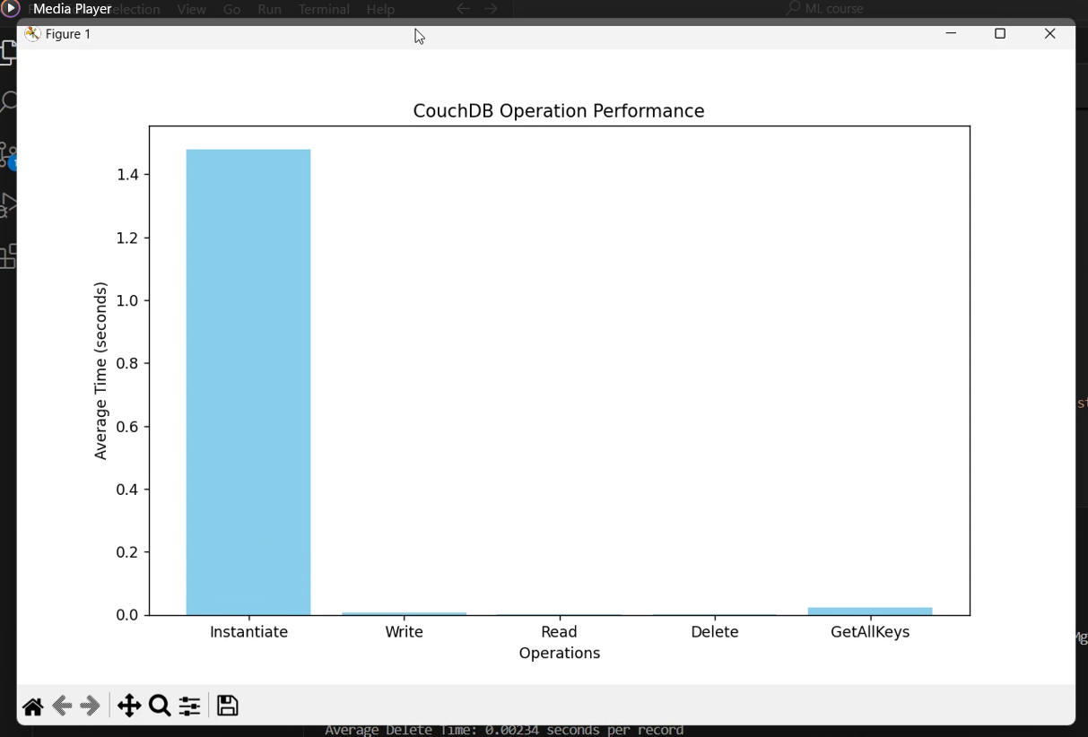
Results : CouchDB

Slide 9
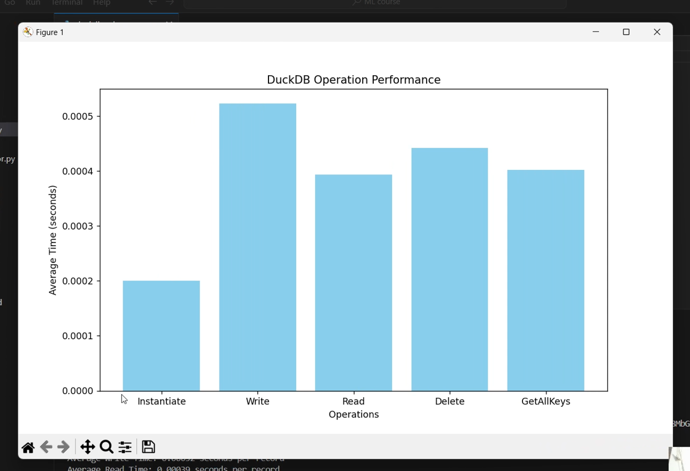
Results : DuckDB

Slide 10
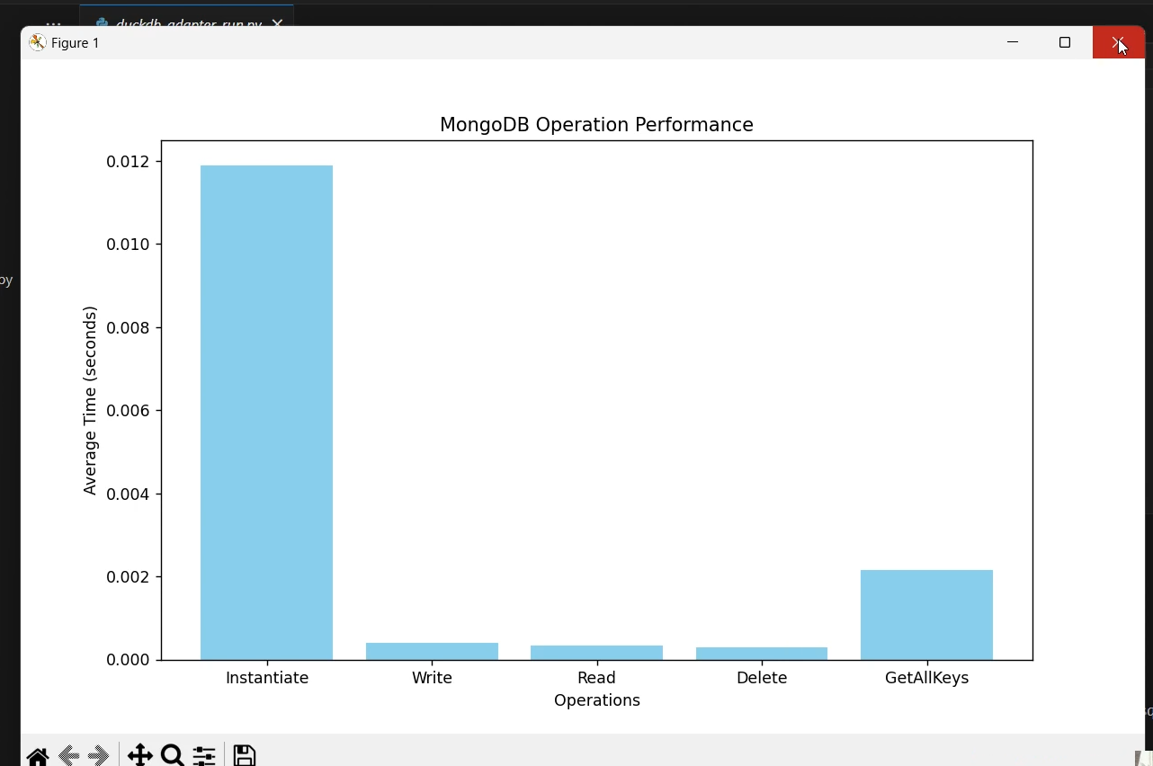
Results : MongoDB

Slide 11
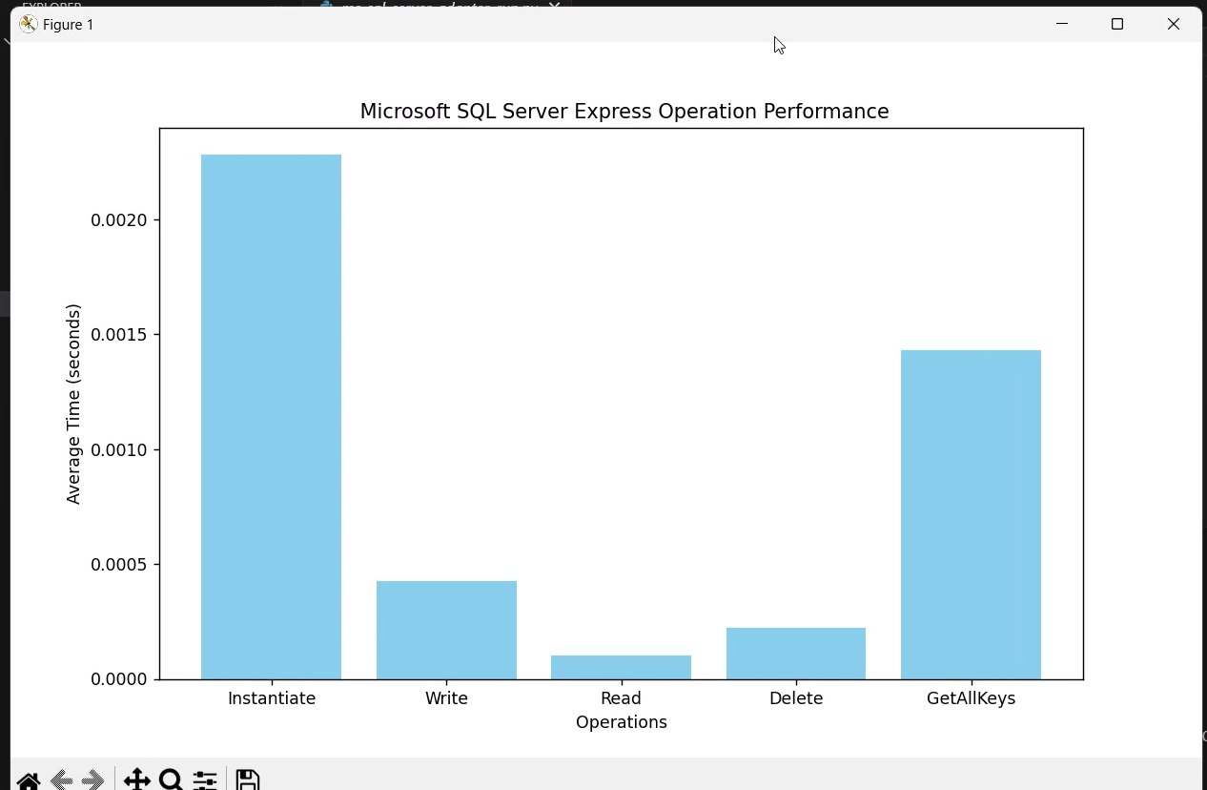
Results : Microsoft SQL Server Express

Slide 12
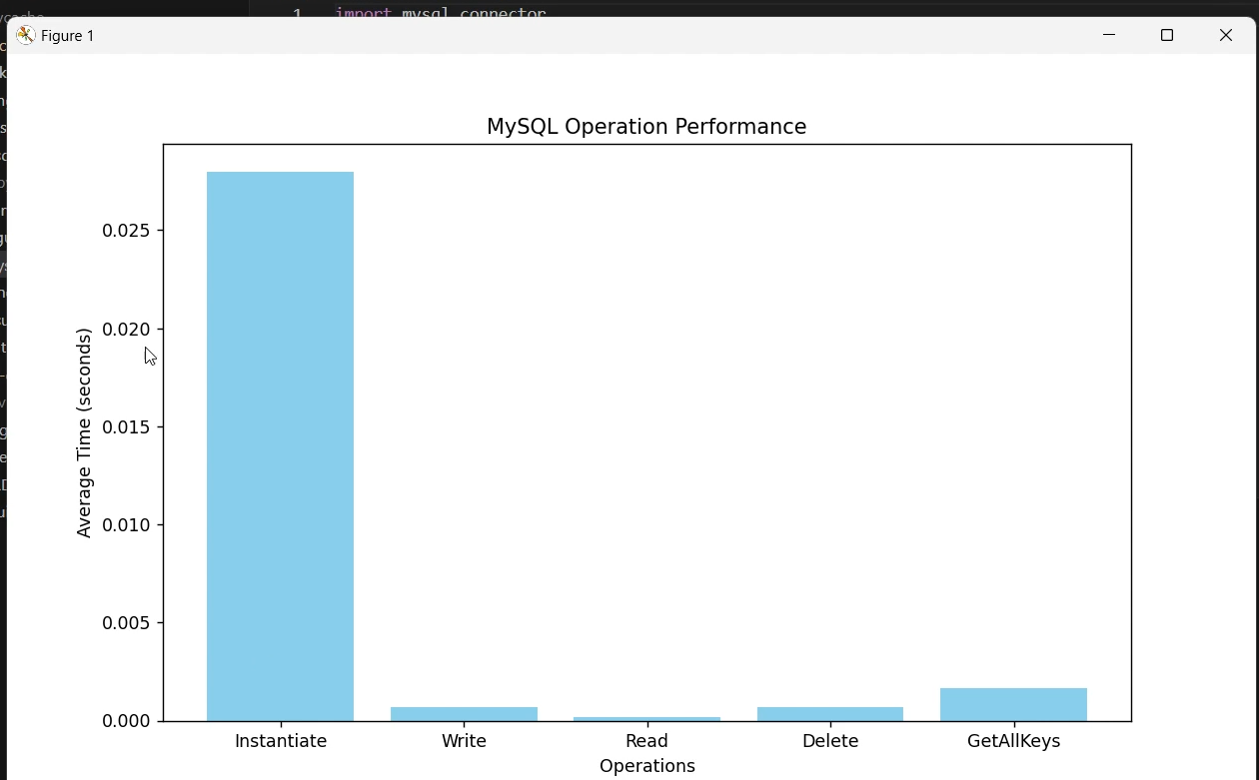
Results : MySQL

Slide 13
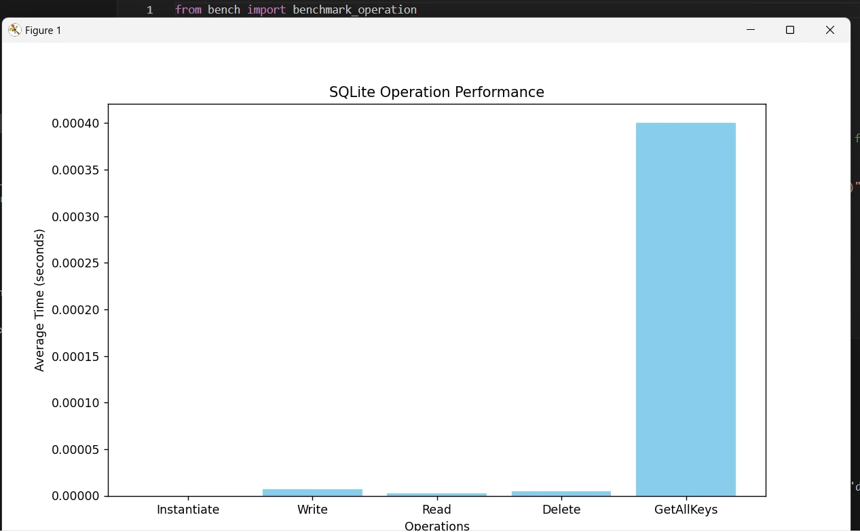
Results : SQLite

Slide 14
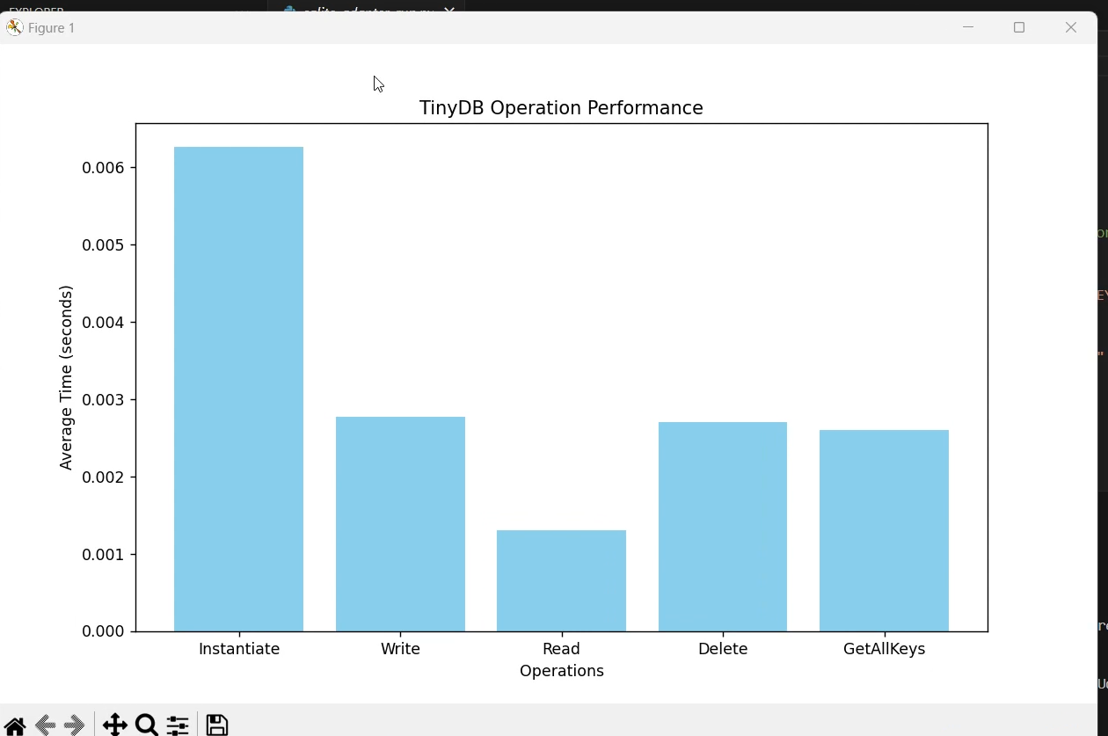
Results : TinyDB

Slide 15
Conclusion
SQL Databases (SQLite, MySQL, MS SQL Server) generally exhibited faster performance across most operations, particularly in Instantiation, Write, Read, and Delete times. SQLite notably led in instantiation, write, read, and delete operations, often showing near-zero operation time per record. MS SQL Server also performed well, especially in read and delete times.
NoSQL Databases (CouchDB, MongoDB, TinyDB) showed a range of performance, with MongoDB excelling in Write and Read operations, performing close to the top SQL databases. CouchDB, however, had slower times for instantiation and delete operations, which may indicate overhead associated with managing larger transactions and data replication processes common to some NoSQL setups.

Slide 16
Conclusion
Key Retrieval (GetAllKeys) was faster in SQL databases (DuckDB, SQLite) than in most NoSQL counterparts, with CouchDB having the slowest performance in this area. This suggests that SQL databases can offer an advantage in applications requiring frequent retrieval of large key sets.
Overall Conclusion: SQL databases, particularly SQLite and MS SQL Server, outperformed NoSQL databases in most metrics. NoSQL databases like MongoDB, however, offer competitive write and read speeds, making them suitable for applications with high write throughput or flexible schema requirements. For tasks involving extensive data retrieval or transaction-heavy processes, SQL databases may provide superior overall performance.

Slide 17
References
Y. Li andS.Manoharan, ”Aperformance comparison of SQL and NoSQLdatabases,” 2013 IEEE Pacific Rim Conference on Communications, Computers and Signal Processing (PACRIM), Vic toria, BC, Canada, 2013, pp. 15-19, doi: 10.1109/PACRIM.2013.6625441.

Slide 18
Thank You!

